Slide 1
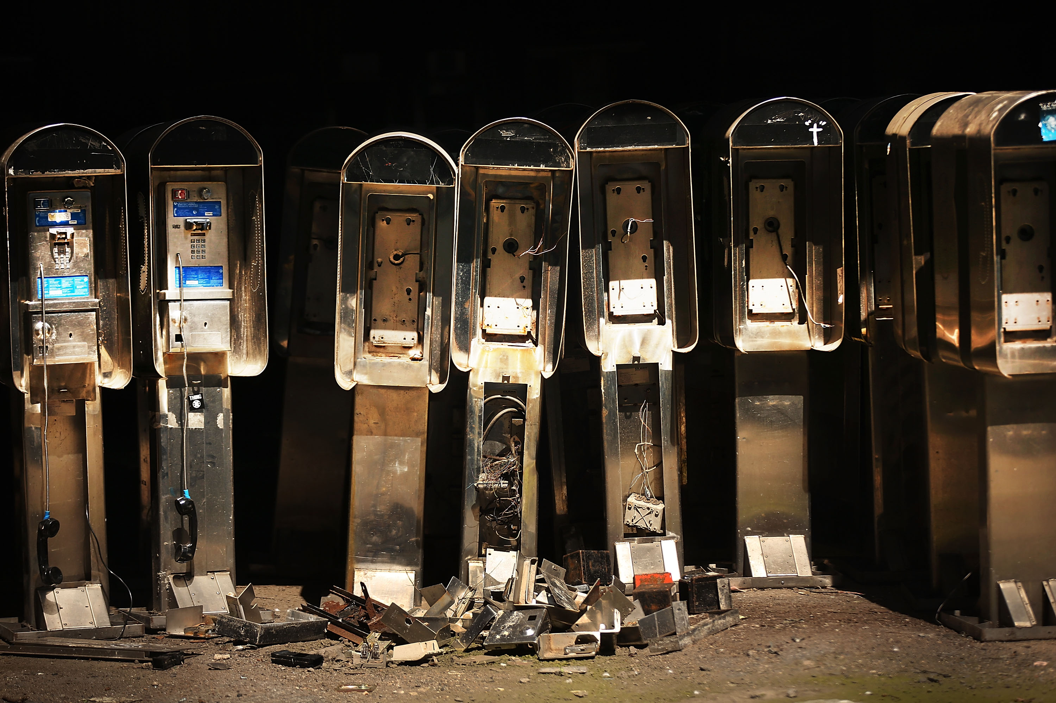
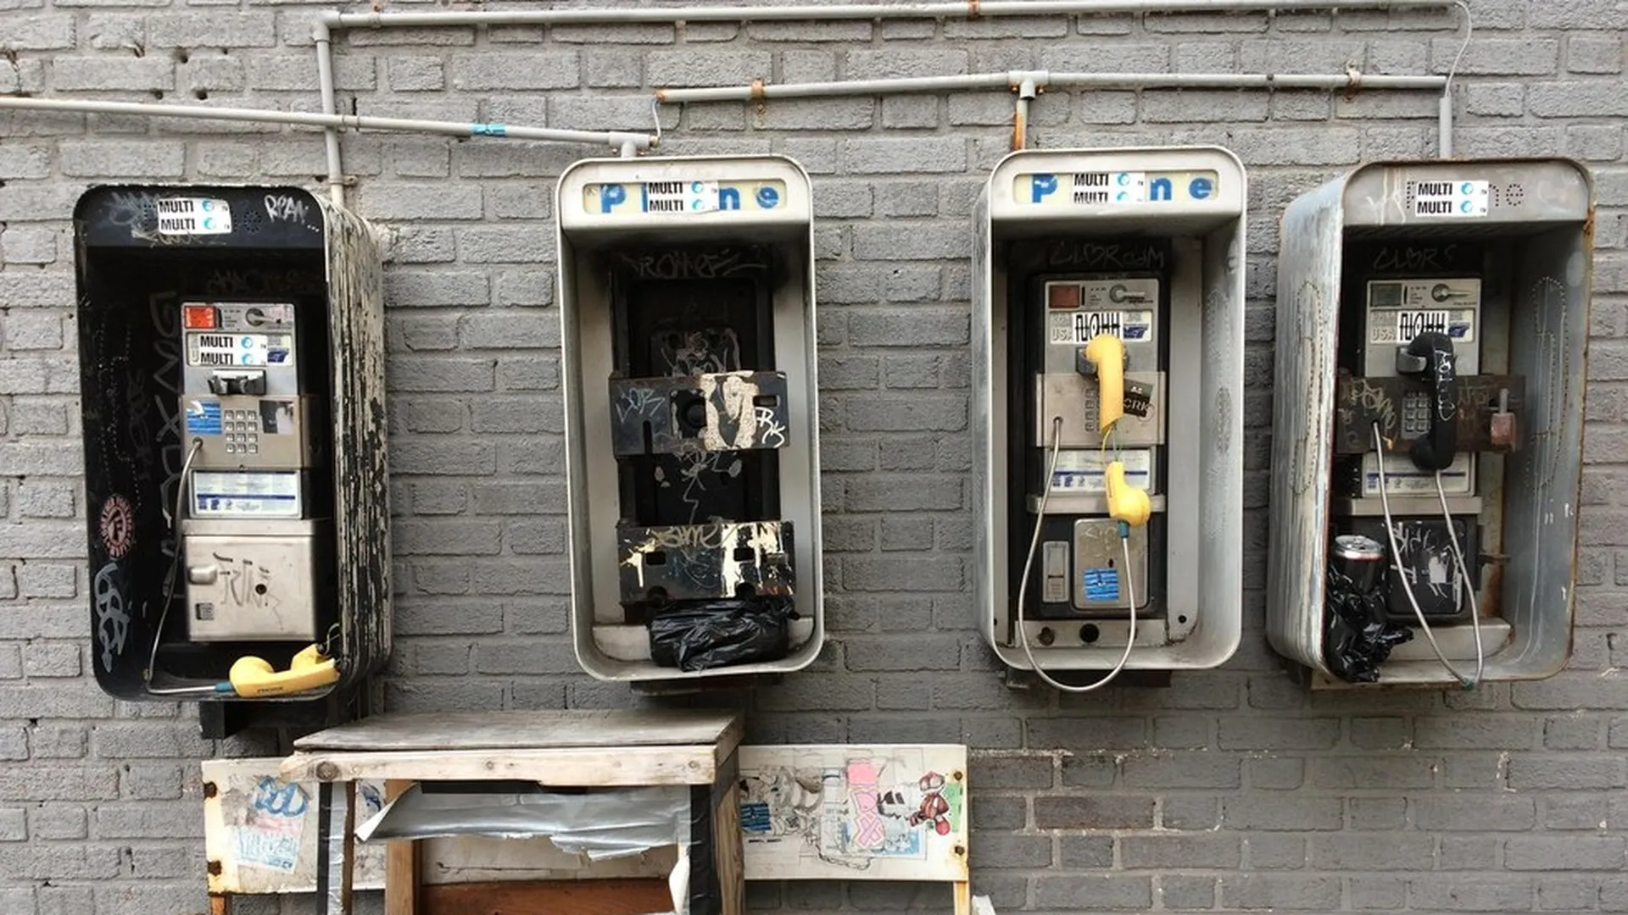
The Payphone You Have Dialed Has Been Disconnected (v2)
The State (and Revival) of Payphones in 2023

Slide 2
Agenda
Who are we?
What’s a payphone?
Interest in infrastructure → Mapping and scanning payphones
The PhilTel project
What is PhreakNet → How PhilTel ties into it
Future Plans

Slide 3
Who are You?
Mike
Software engineer
Philly 2600 (2012-)
FreePBX/Asterisk user (2012-)
Networks of Philly (2018-)
Dialup.world (2021-)
Naveen
Computer engineer, IT
Telephone collector, phone phreak (2016-)
Asterisk user (2018-)
Payphone inventory (2019-)
PhreakNet (2021-)
Asterisk/DAHDI developer and consultant (2021-)
BBS software developer (2022-)
Environmental activist (2016-)

Slide 4
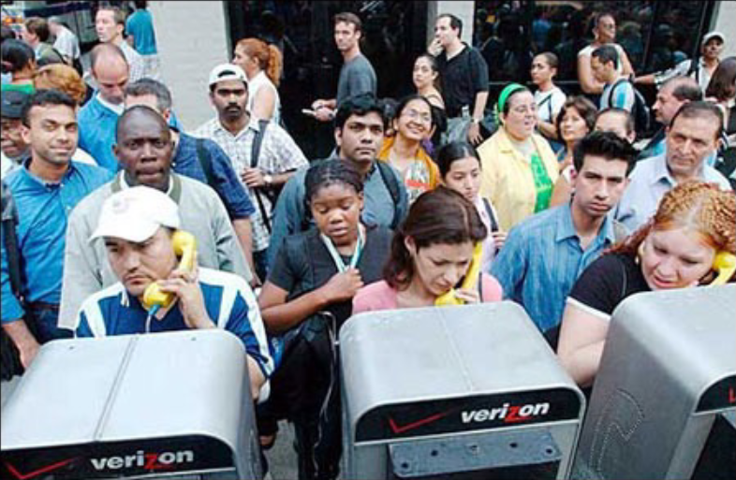
What is a Payphone?

Slide 5
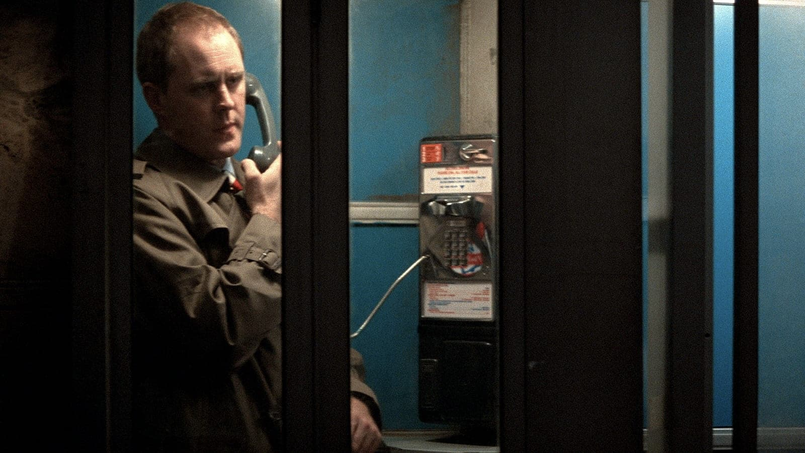
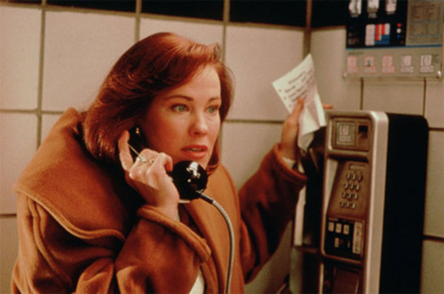
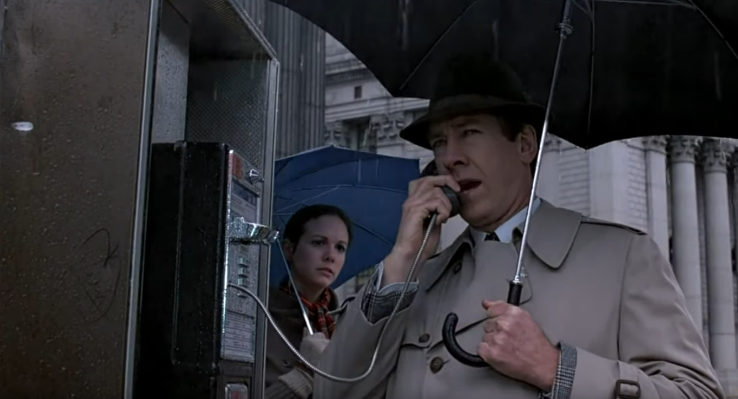
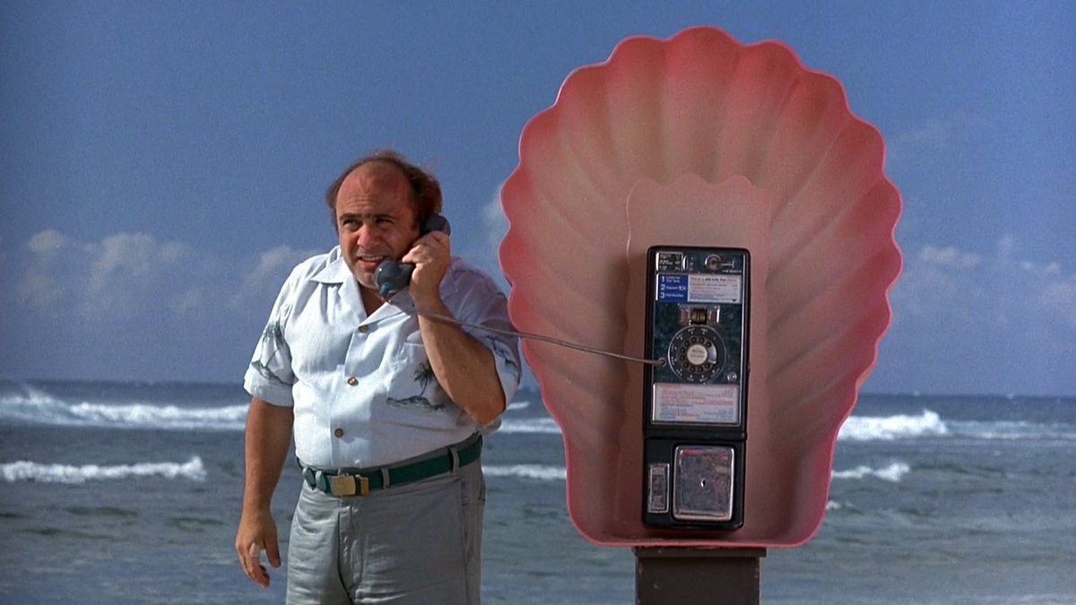
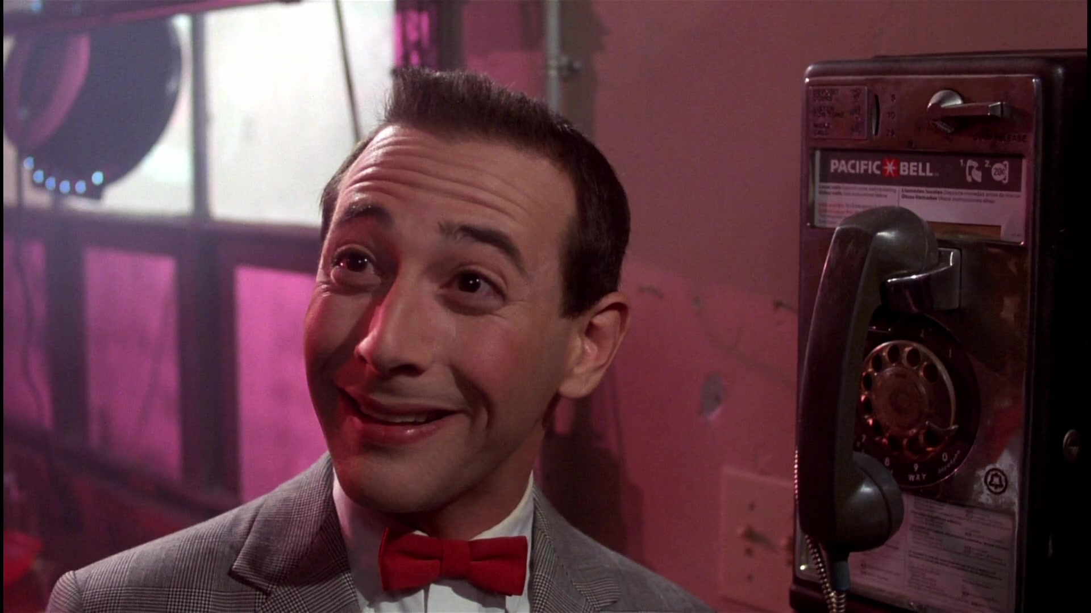
What is a Payphone?

Slide 6
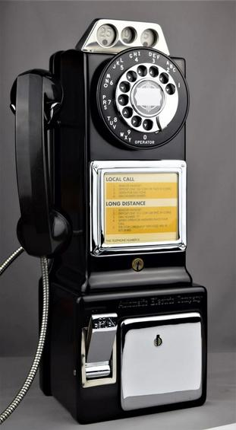
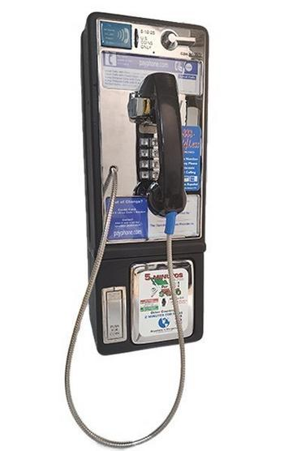
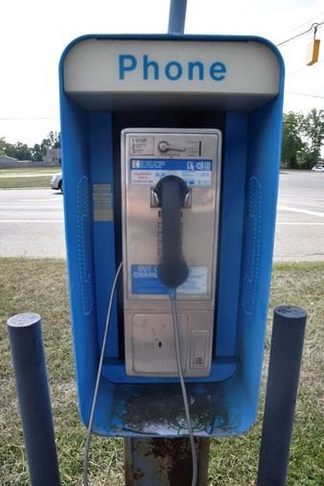
What is a Payphone?

Slide 7
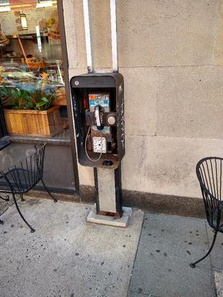
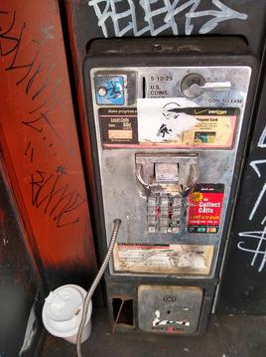
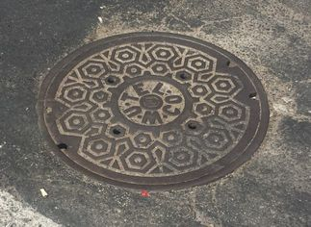
Networks of Philly
Networks of Philly is a project attempting to discover and understand network infrastructure all around us.
https://networksofphilly.org

Slide 8
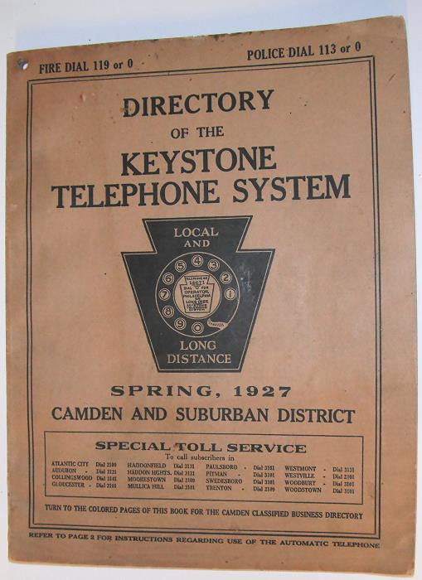




Local Telco Infrastructure

Slide 9
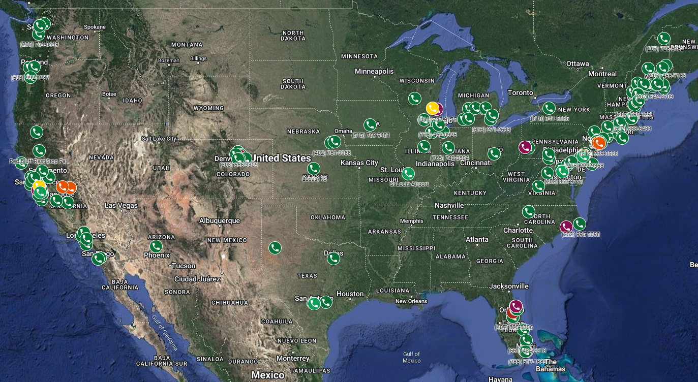
Where Can You Find A Payphone?
https://phreaknet.org/payphones/

Slide 10
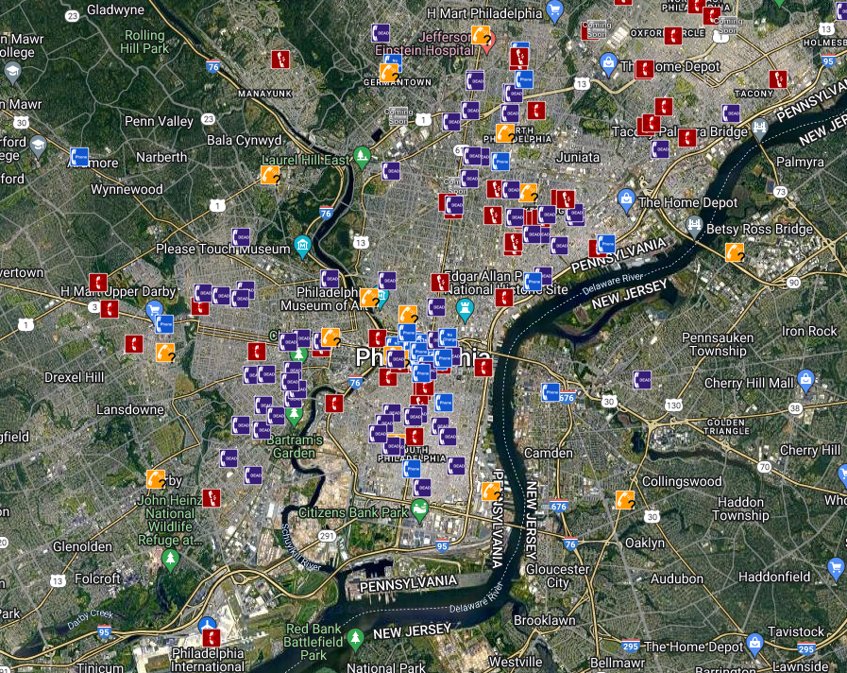
Local Payphones

Slide 11
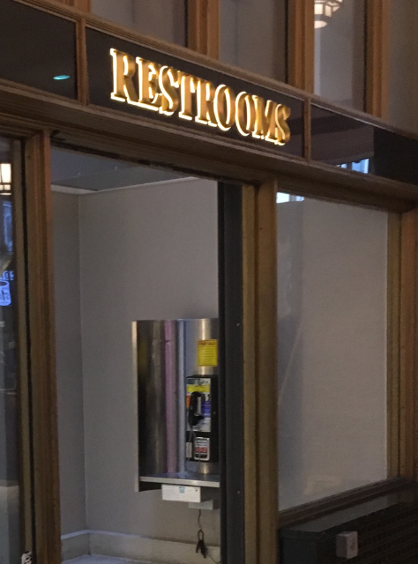
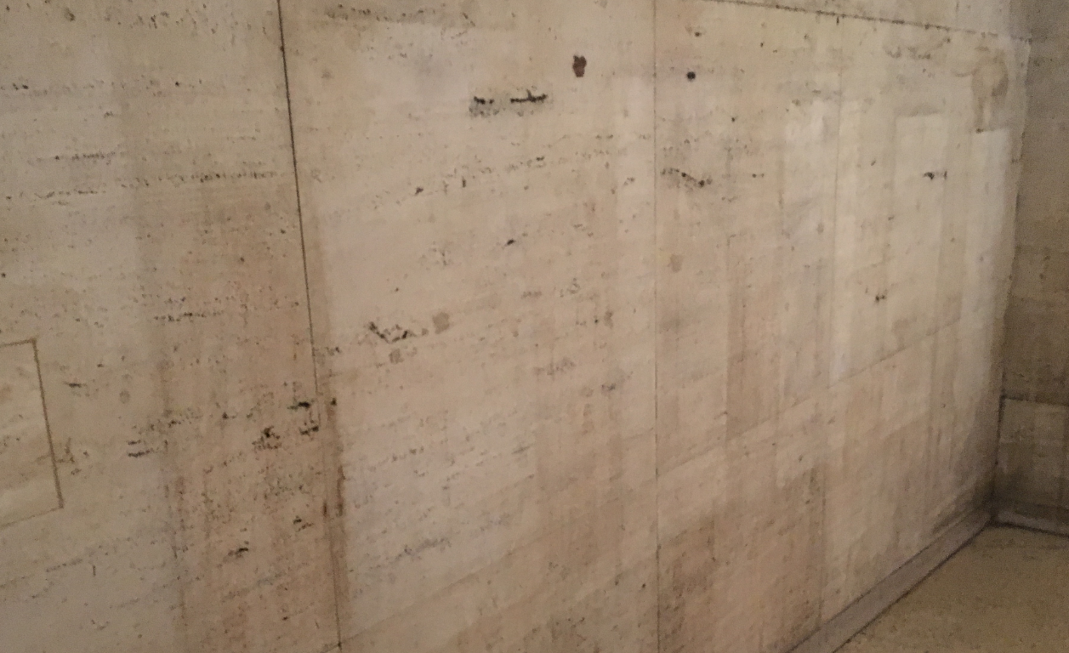
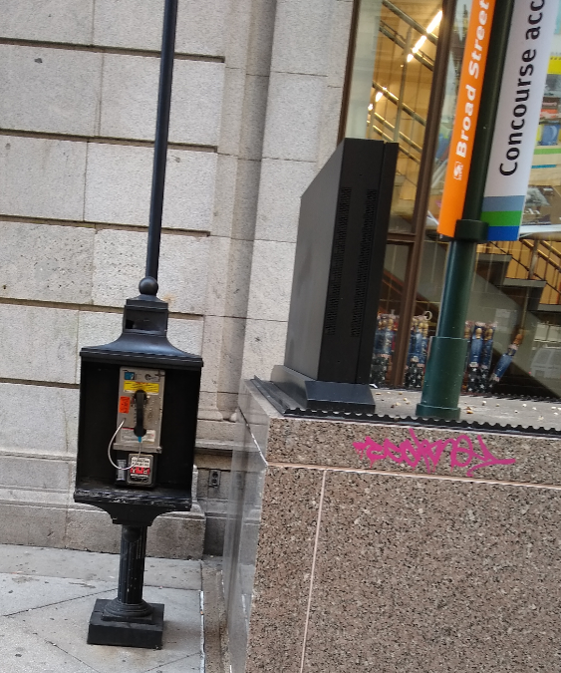
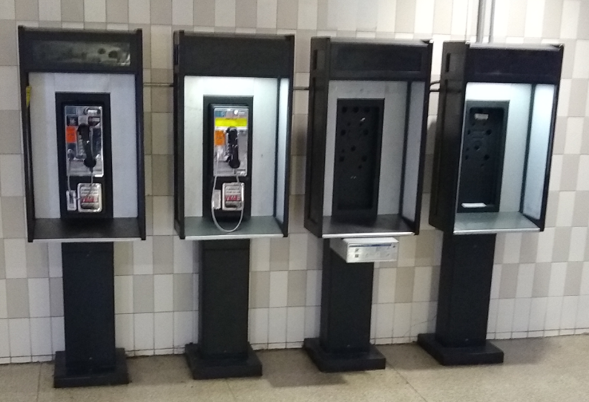
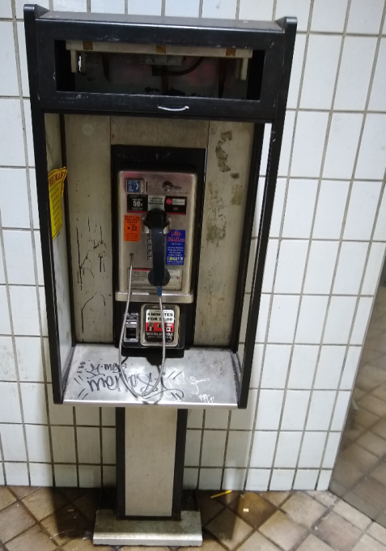
Local Payphones

Slide 12
What Happens If You Call A Payphone?
Historically, they would… ring!
No charge for answering incoming calls
Bell System had policies to prevent fraud
COCOTs typically answer with a 300/1200 baud modem
Remote management
Reporting
Security…

Slide 13
Protel Printouts
TC!*2152229996*72765*DD8822*4868*025*2210301004552*67805*
Number
(215)
222-9996
Amount in
Coin Box
$727.65
-$678.05
= $49.60
Model No.
% Full
= 25%
Balance When Last Emptied
$678.05
Checksum?
PIN?
Only changes when emptied…
but not every time
Local Timestamp
2022
October 30
00:45 local time
(12:45 am EDT)

Slide 14
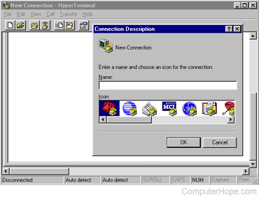


Automating It…
Usage summaries posted monthly in the NIPCAQ
https://phreakscan.com

Slide 15
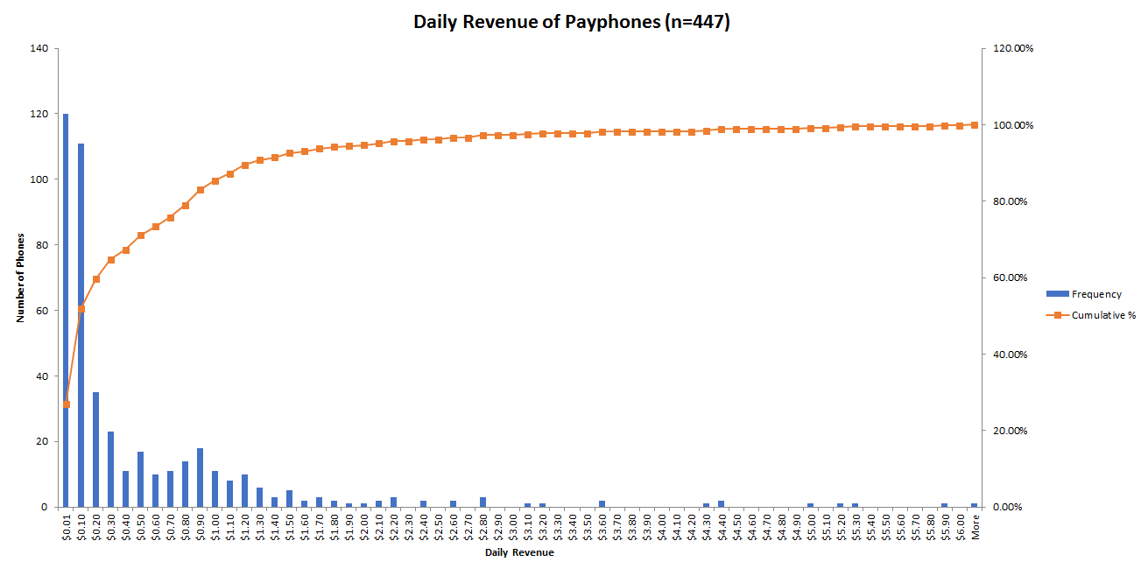
Payphone Revenue

Slide 16
ANACs
Identify the calling line
(800) 444-4444 – MCI
(800) 437-7950 – MCI
(844) 700-0431 – Payphone Reporting Line
Email payphones@phreaknet.org with the number and location

Slide 17
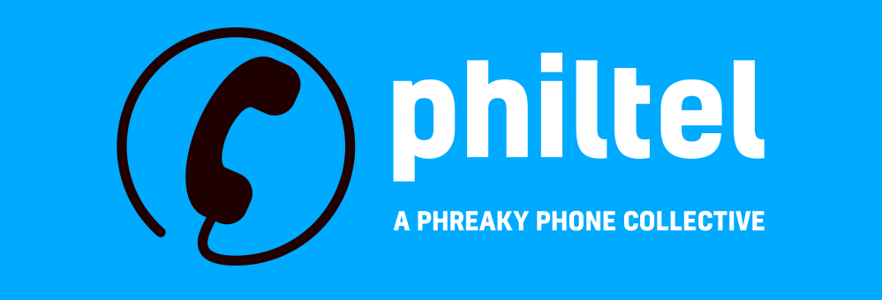
“Let’s start our own telco”
PhilTel is inspired by Futel, based out of Portland, Oregon
Bring payphones back but make them free-to-use this time (yes, we know it is a misnomer) because payphones are cool
Use as much discarded and second-hand stuff as we can, build with COTS hardware and open-source software
Large upfront cost (>$300), small recurring cost (<$10/mo)
Benefit people without cell phones

Slide 18
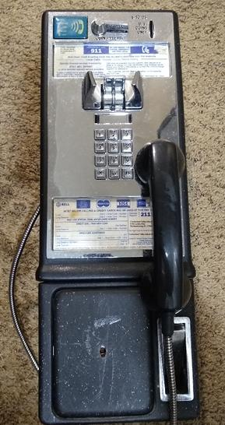
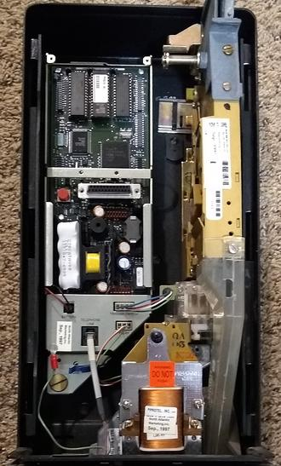
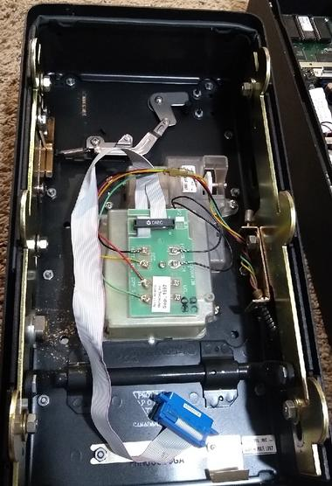
Payphone Hardware (COCOT)

Slide 19
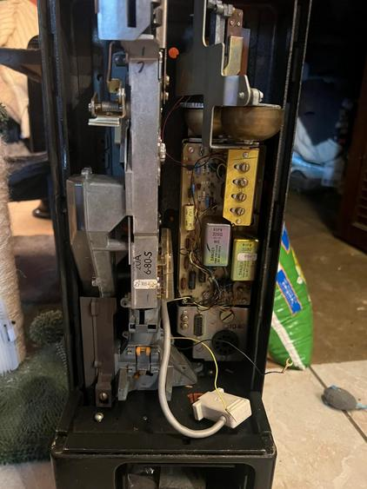
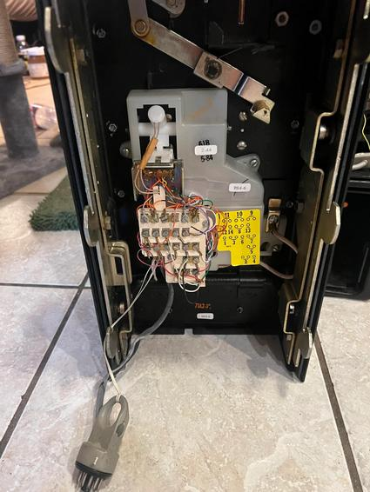
Payphone Hardware (Coin Line)

Slide 20

Okay, now what?

Slide 21
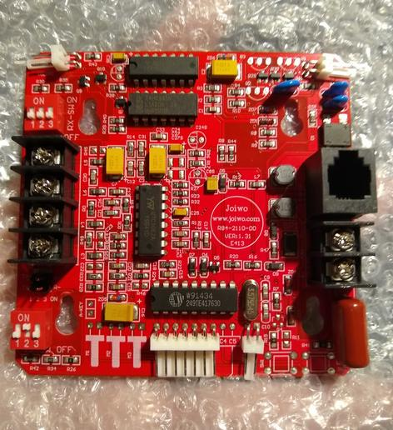
2110V Coinless Board
“Dumb” phone board made for armored phones
Acts as an (almost) drop-in replacement board for most payphones
No longer made (but still available)

Slide 22
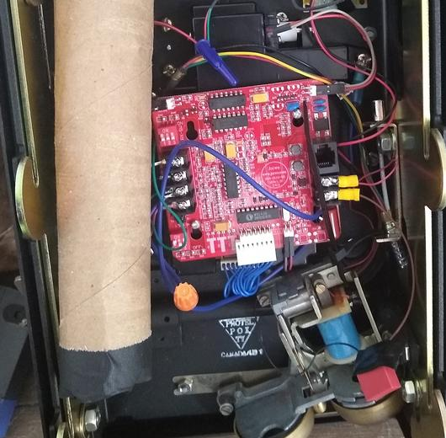
2110V Coinless Board (Continued)

Slide 23
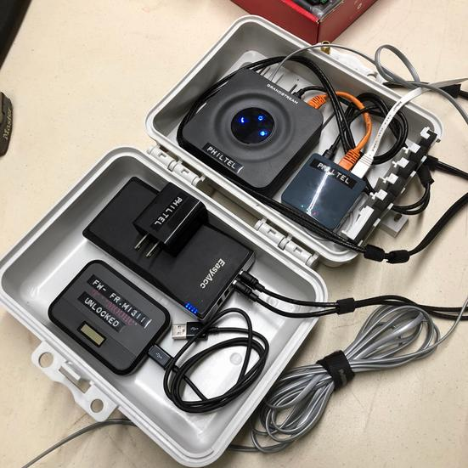
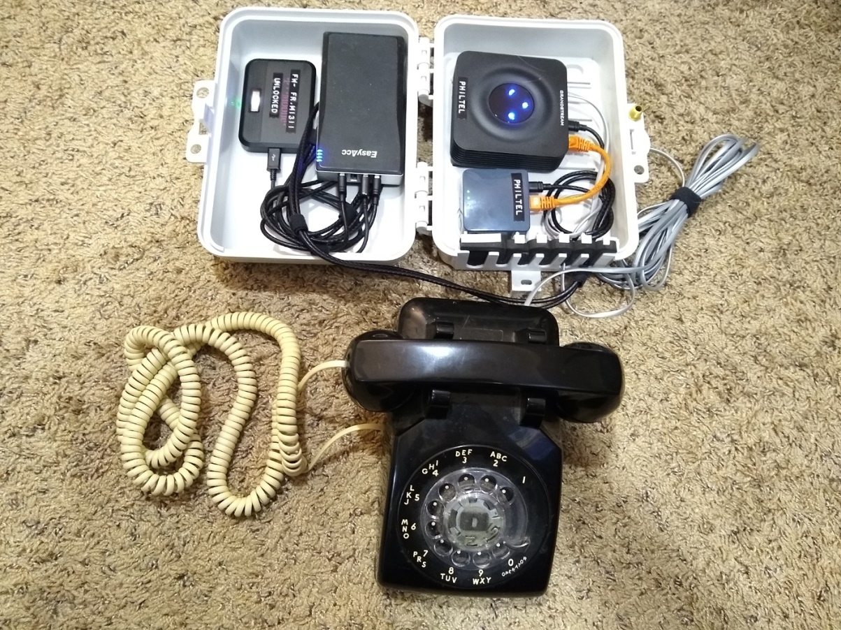
Our Portable Proof of Concept

Slide 24
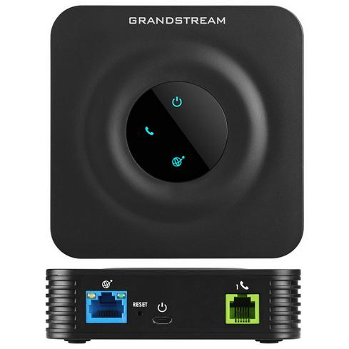
Grandstream HT801 ATA
Analog Telephone Adapter
Allows analog telephones to speak SIP (Session Initiation Protocol)
Registers as a client to our telephone exchange so we can make/take calls
Remotely monitored with GDMS (Grandstream Device Management System) for free!

Slide 25
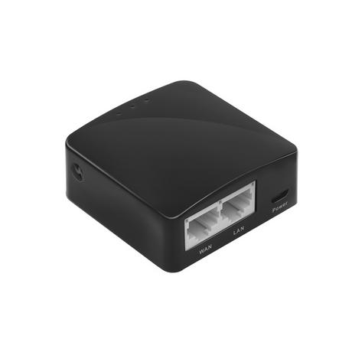
GL.iNet AR300M Router
Low-cost travel router
Runs OpenWRT natively
Used as an OpenVPN client and/or WiFi bridge

Slide 26
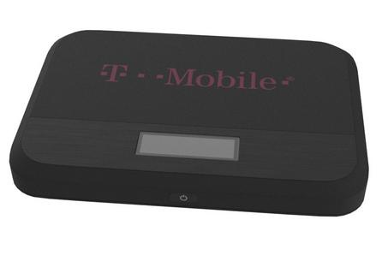
Franklin T9 Hotspot (optional)
T-Mobile used to give these away for free!
Stock, it works for T-Mobile or any carrier that piggybacks on T-Mobile
Easy to SIM unlock for other carriers: echo -n "${IMEI}simlock" | sha1sum | cut -c1-8
Fairly easy to root, many hidden/debug pages

Slide 27
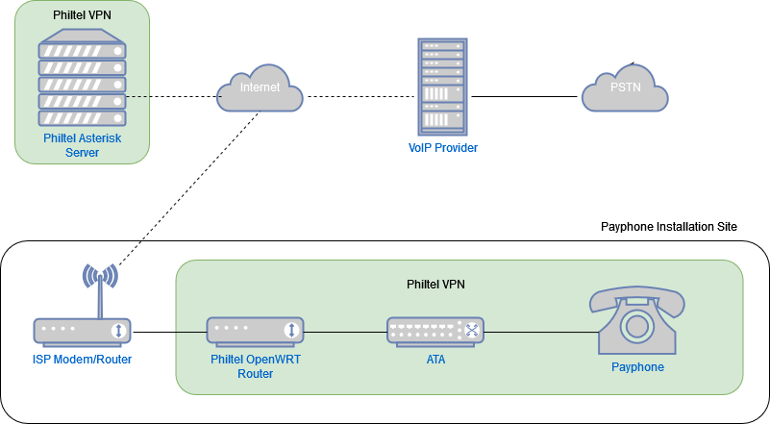
Putting It All Together

Slide 28


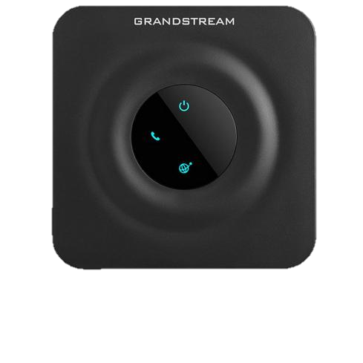
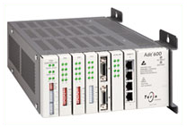
SIP provider
Asterisk
VoIP
SIP/RTP
IAX2
DAHDI
T1

Slide 29
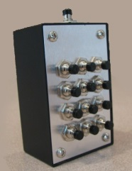
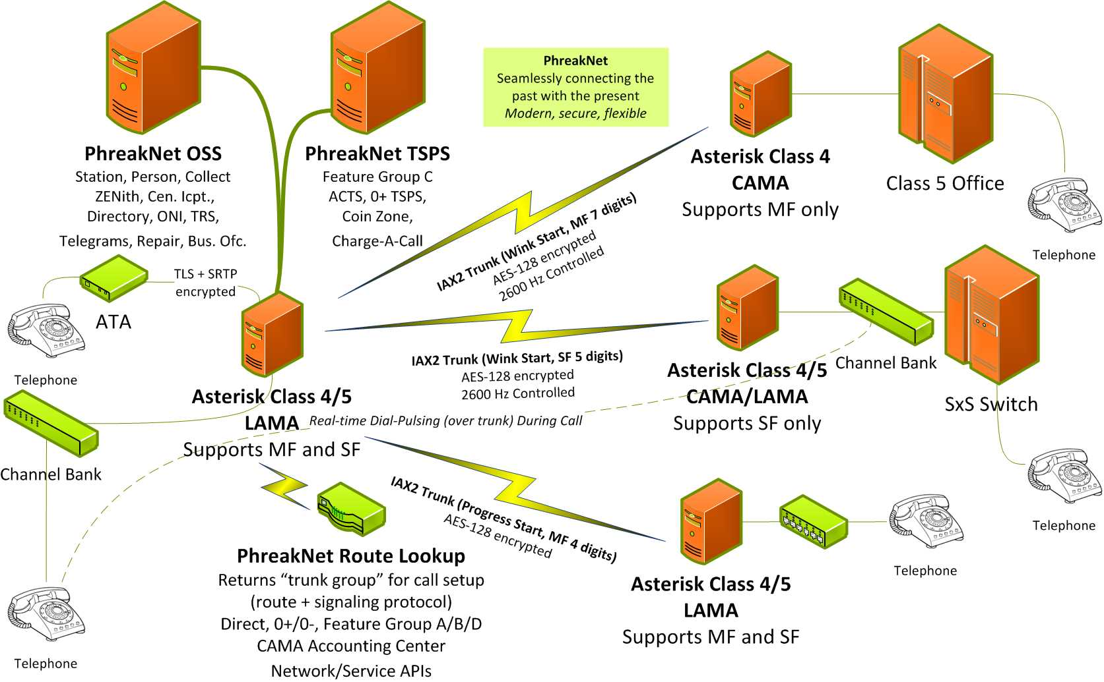
PhreakNet
Red Boxable
Blue Boxable
https://portal.phreaknet.org

Slide 30
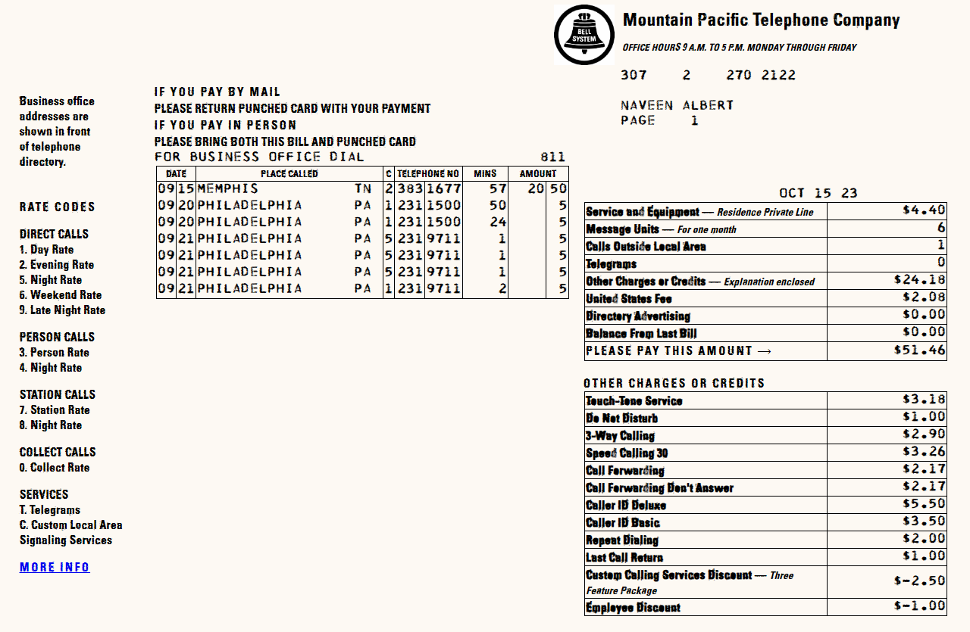
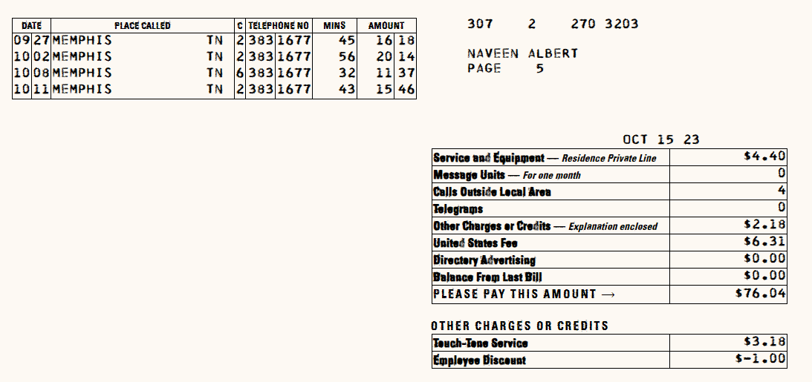
Billing

Slide 31
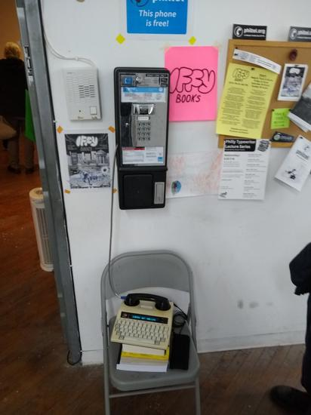
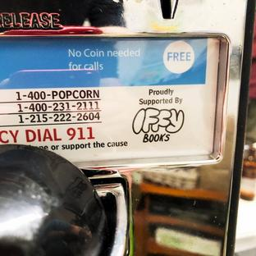
Flagship Phone @ IffyBooks
Installed December 17, 2022 (and reinstalled in January)
Had a party, hackers and phreakers showed up
Has to move again soon!

Slide 32
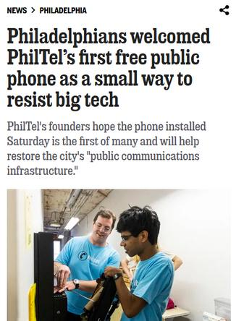

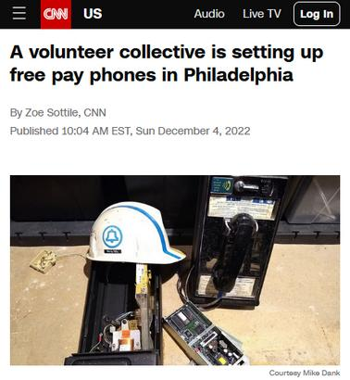
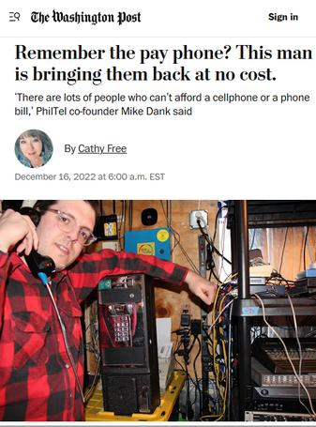


People seemed to like it

Slide 33
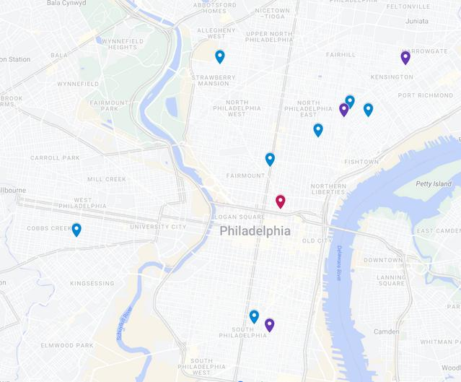
Future: More Installations

Slide 34



Future: More Installations
New phone in the works for Thunderbird Salvage on Frankford Ave in East Kensington/Fishtown
Phone is new old stock with an electromechanical brass ringer
Will be installed inside a real red British phone box!
Raising funds -> https://philtel.org/donate

Slide 35




Future: Free COCOT Programming Line, Archaeology & Archiving

Slide 36
Questions?
Mike
mike@philtel.org
Famicoman (Libera IRC)
https://famicoman.com
https://github.com/Famicoman
Naveen
interlinked@philtel.org
InterLinked (Libera IRC)
https://interlinked.us
https://github.com/InterLinked1
https://philtel.org/contact/
https://philtel.org/donate/
https://github.com/philtelco/philtel-presentations/

